Slide 1

Telco Churn prediction
Using Machine Learning
Github link

Slide 2

Agenda Github link: Telco Customer churn prediction
Introduction
Data cleaning
Exploratory Data Analysis
Splitting the dataset into Independent and Target variables
Creating Train and Test splits
Creating a Logistic Regression model, predicting and testing the accuracy
Creating other models?
Conclusion

Slide 3
Introduction
With the increase in the number of competitors in the market in the tele communication domain, telecom companies face a tough competition with each other in maintaining their existing customers as well as adding new customers to their network.
In this project we will be using a Telco’s dataset from this link and create a model to predict the Customer Churn.
The dataset consists of data for 7043 customers with 21 column details like:
Gender
Senior Citizen
Partner & Dependents
Tenure
Type of service a customer has
Contract type
Total charges and many other columns.

Slide 4
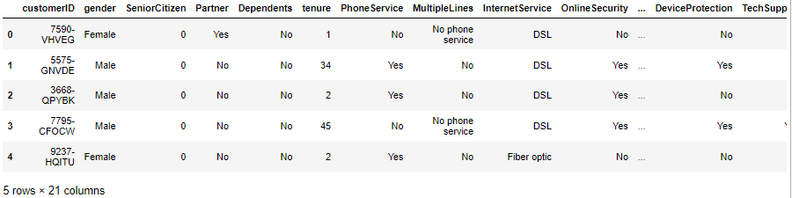
Data Cleaning
Shape of dataset: 7043 X 21
Blanks: There were no blanks in the dataset
Duplicates: There were no duplicates in the dataset

Slide 5
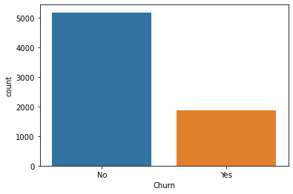
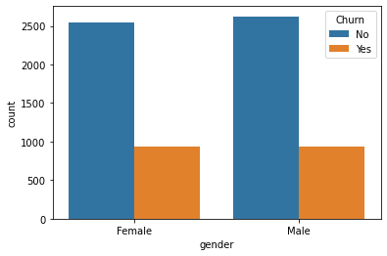
Exploratory Data Analysis
Churn column: Is imbalanced, it has 5174 “No” and 1869 “Yes”
Gender wise churn split: The Churn rate is balanced

Slide 6
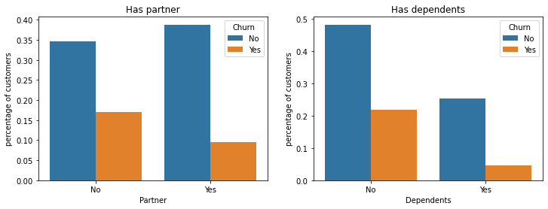
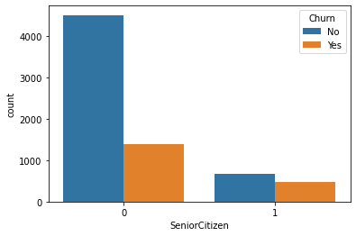
Exploratory Data Analysis
Looking at Partner & Dependents combined:
Looking at the Partner and Dependent combination, we can say that there are more customers who do not have dependents.
Senior Citizen: There are very few Senior Citizen customers in the dataset.

Slide 7
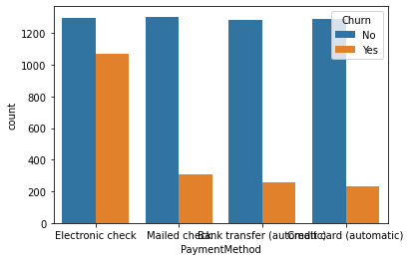
Exploratory Data Analysis
Payment Method: Looking at the churn rate based on the Payment method we can say that maximum number of customers prefer electronic check.

Slide 8
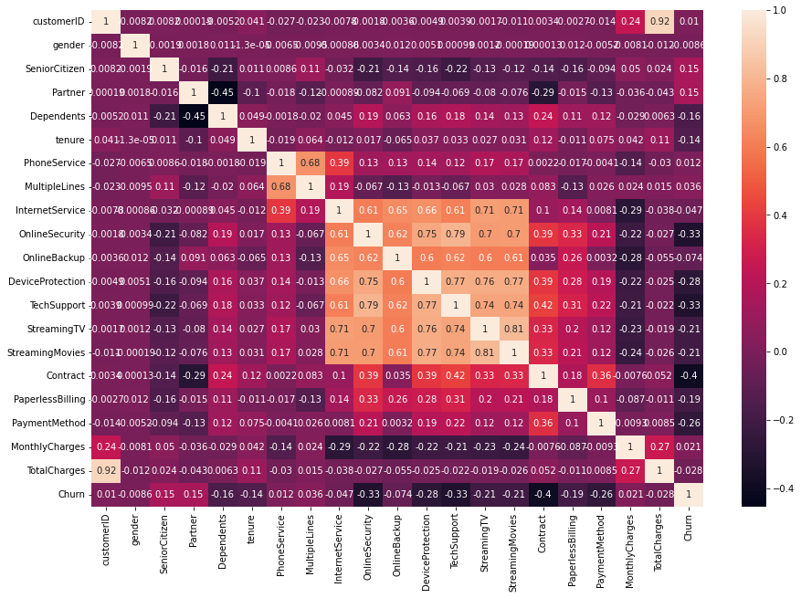
Exploratory Data Analysis
Correlation:
Looking for correlation between all the features we can see that there is strong correlation between Streaming Movies and Streaming TV features.

Slide 9
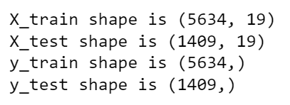
Creating Train and Test splits
We use LabelEncoder() to convert all the non numeric fields to numeric in the dataset.
Using the sklearn train test split we convert the data into train and test splits, with a test size of 20%.
The shape of the test and train datasets is below:

Slide 10
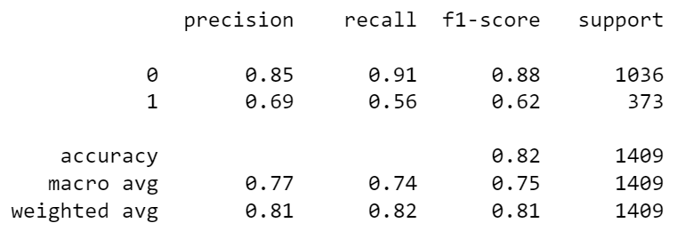
Creating Logistic Regression model
We create a Logistic regression model with the below parameters:
LogisticRegression(C=1.0, class_weight=None, dual=False, fit_intercept=True, intercept_scaling=1, l1_ratio=None, max_iter=100, multi_class='auto', n_jobs=None, penalty='l2’, random_state=None, solver='lbfgs', tol=0.0001, verbose=0, warm_start=False)
We fit the xtrain and ytrain with the above model and then create predictions data.
We get the below metrics by running the classification report:

Slide 11

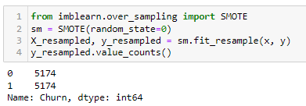
Balancing the Churn data
As the churn field is imbalanced, i.e., it has unequal records for Yes and No.
We try to balance the Churn field by using the SMOTE over_sampling algorithm from the imblearn class.
The over_sampling SMOTE algorithm creates samples of the “Yes” class to balance the overall target variable.

Slide 12
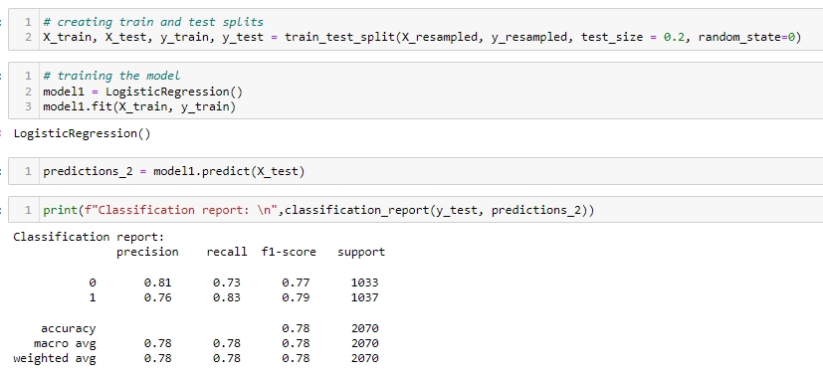
Using the updated dataset for training the Logistic Regression model
Using the updated dataset for training the Logistic Regression model, we get a reduced accuracy score of 78%.

Slide 13
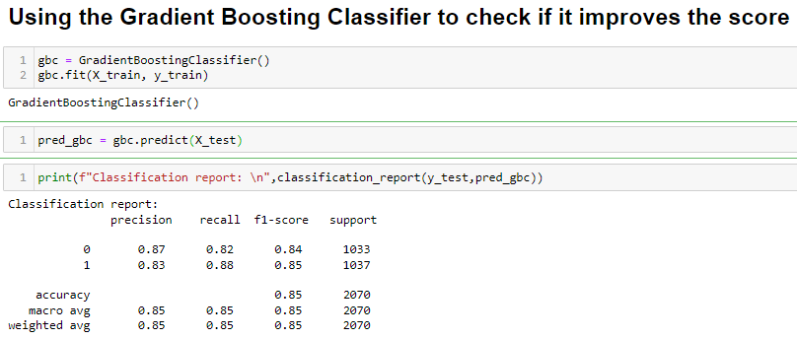
Using Gradient Boosting Classifier
We try using a Gradient Boosting Classifier to see if it can improve the accuracy score of the model.
We get a boost in the overall accuracy of the model to 85%.

Slide 14

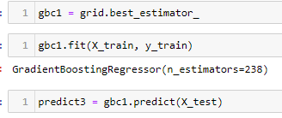
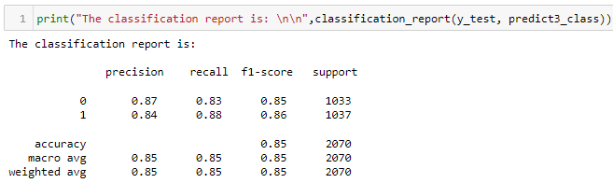
Using Gradient Boosting Classifier: Hyper parameter tuning
We try to tune the hyper parameters to improve the accuracy of the Gradient Boosting Classifier.
We use GridSearch CV to find the most suitable number of n_estimators between 1 to 500.
Using the recommended n_estimator 238 we get the below accuracy of 85%.

Slide 15

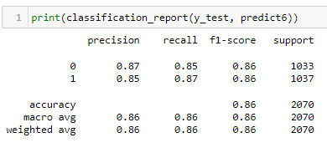

Using Gradient Boosting Classifier: Hyper parameter tuning
We try to look for the best learning rate and n_estimators along with the best max_depth for the model.
Using the recommended parameters we get 86% accuracy.

Slide 16
Conclusion
The logistic regression model gives us 82% accuracy which is a very good accuracy for customer churn prediction.
After balancing the data strangely we got a reduction in the accuracy of the model.
After trying the Gradient Boosting Classifier algorithm along with GridSearch CV for finding optimum parameters we get an increase in the overall accuracy of the model to 86%.

